Slide 1

Loan Data Analysis
Here in this Data analysis we will see that how the different factors effects on the loan and which factor is most affected on take a loan.
Here we analyse that applicant is capable for take loan.

Slide 2
Machine Learning Model Building Stages
1
2
3
Data Exploration and Visualization
Data Pre-procesasing
Model building and Evaluation

Slide 3
Overview of Data
column name | column description
Loan ID | Unique Loan ID
Gender | Male / Feamle
Married | Married Status ( Yes / No )
Dependents | Number of Dependents
Education | Applicant Education ( Graduate / Not Graduate
Self_Employed | Self Employed ( Yes / No )
column name | column description
ApplicantIncome | Income of applicant
CoapplicantIncome | Co-applicant income
LoanAmount | Amount of the Loan
Loan_Amount_Term | Time period of Loan
Credit_History | Credit History
Property Area | Property ( Urban / Rural / Semiurban )
Loan Status : The loan is approved or not - ( Yes / No)

Slide 4
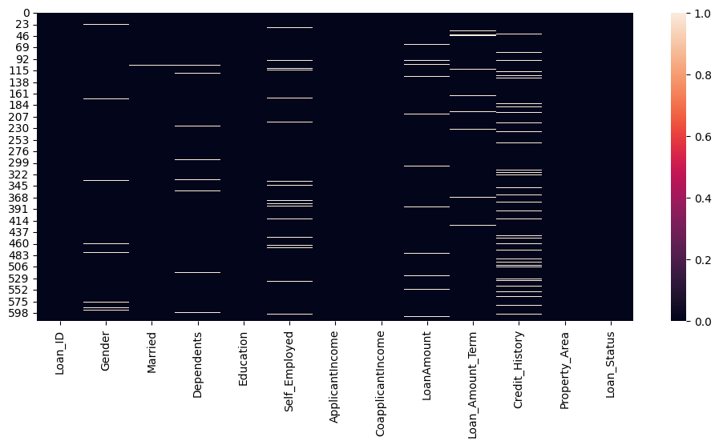
First we check in our data that any value is missing or not
Here we can see that there are some columns have the missing values so we can fill the data using the mean , median and mode or remove this data.

Slide 5
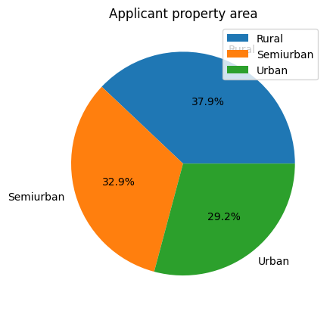
Now, let’s visualize each variable separately.
Different types of variables are Categorical, ordinal, and numerical
Categorical features: These features have categories (Gender, Married, Self_Employed, Credit_History, Loan_Status)
Ordinal features: Variables in categorical features having some order involved (Dependents, Education, Property_Area)
Numerical features: These features have numerical values (ApplicantIncome, CoapplicantIncome, LoanAmount, Loan_Amount_Term)

Slide 6
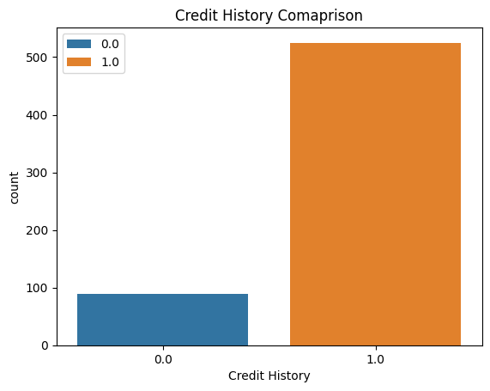
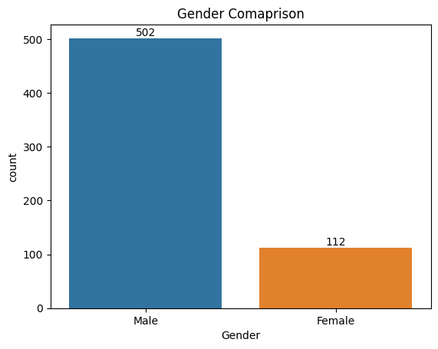
Now, let’s visualize each variable separately.
Credit_History | Credit_History
0.0 | 89
1.0 | 525
Gender | Gender
Male | 502
Female | 112

Slide 7
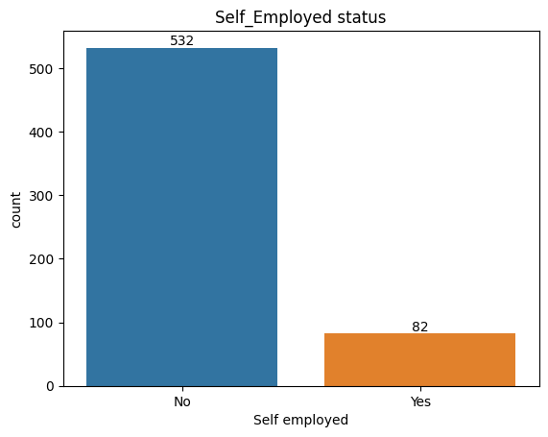
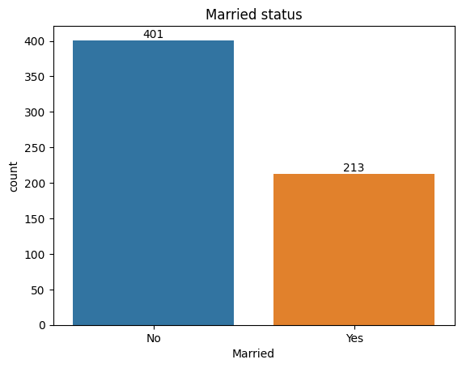
Now, let’s visualize each variable separately.
self employed | self employed
Yes | 82
No | 532
Married status | Married status
Married | 401
Unmarried | 213

Slide 8
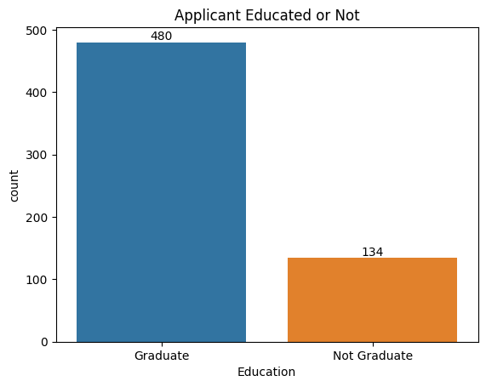
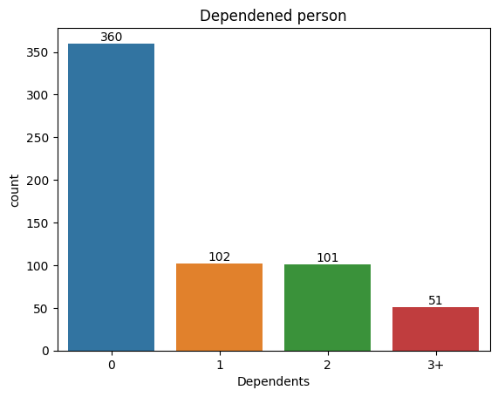
Now, let’s visualize each variable separately.
Education | Education
Graduate | 480
Not Gradute | 134
Dependents | Dependents
0 | 360
1 | 102
Dependents | Dependents
2 | 101
3+ | 51

Slide 9
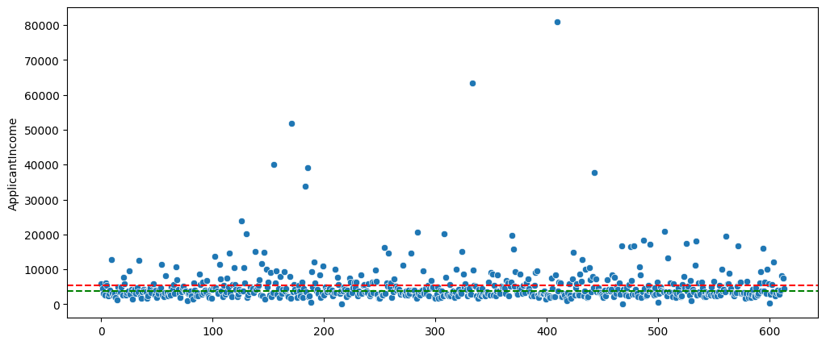
Let’s Find outliers of our Data.
Here in this graph we can show the applicant Income range. Here mostly data is lie between the range of 15000 around.

Slide 10
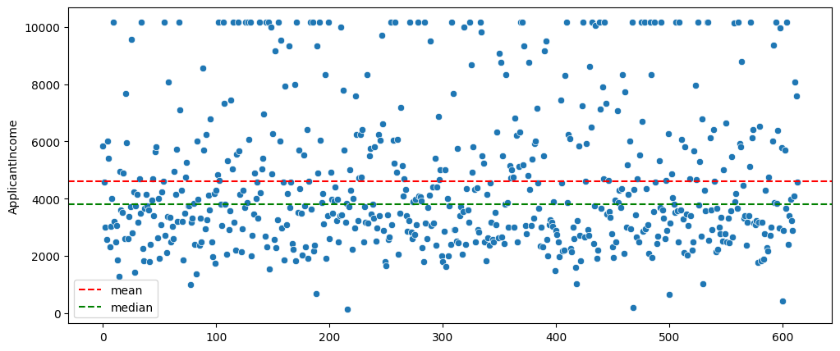
Its is most important thing to remove the annomaly data. If we can not remove it so our prediction may be wrong

Slide 11
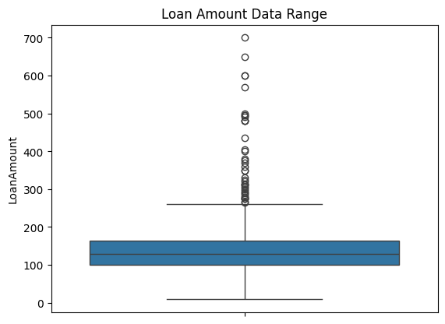
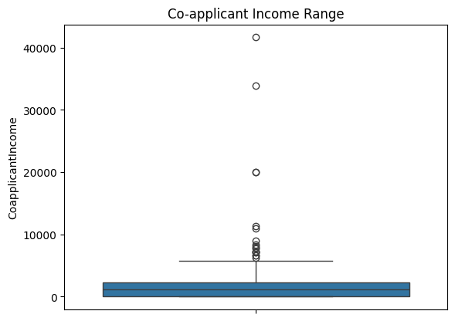
Here we show the different columns has outliers or not.
Here the show two columns on is loan amount data Range and another is co-applicant income range. In the loan amount data range data is mostly lie between the 0 to 300 and another data is outliers as well as in the coapplicant income data is mostly lier between the 0 to 9000 another data is called the outliers.

Slide 12
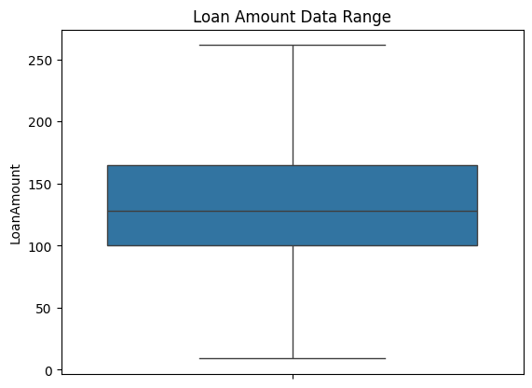
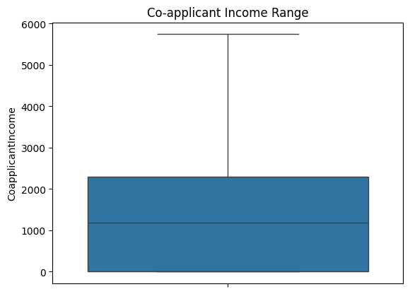
After removing the outliers.

Slide 13
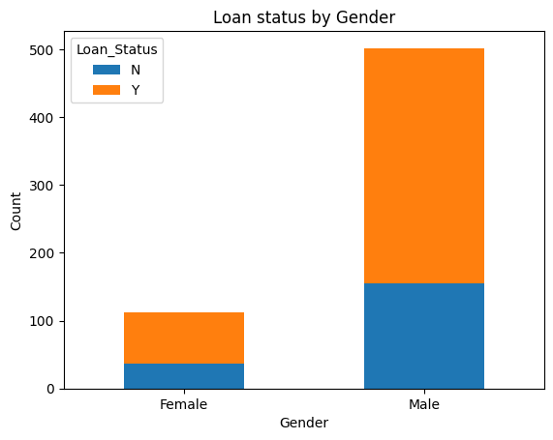
Here we analyze that every factor is impact the loan or not. Here we will analyse the Gender
we will find the relation between the target variable (Loan status) and categorical independent variables (Gender).
Gender | Total | Loan(%) (Y)
Male | 502 (82%) | 347 (69%)
Female | 112 (18%) | 75 (66%)

Slide 14
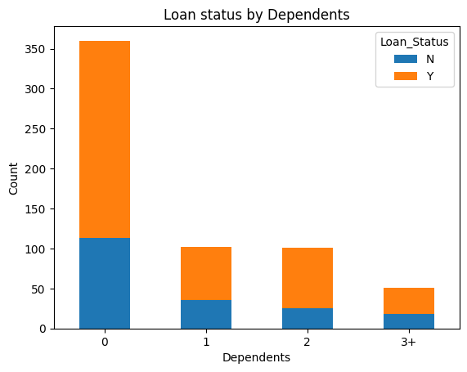
Here we analyze that every factor is impact the loan or not. Here we will analyse the Dependents
we will find the relation between the target variable (Loan status) and categorical independent variables (Dependents).
Dependents | Total | Loan Status (Y)
0 | 360 (59%) | 247 (68%)
1 | 102 (17%) | 66 (64%)
2 | 101 (16%) | 76 (75%)
3+ | 51 (8%) | 33 (64%)

Slide 15
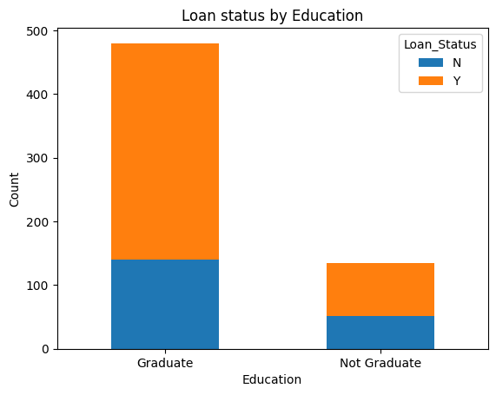
Here we analyze that every factor is impact the loan or not. Here we will analyse the Education
we will find the relation between the target variable (Loan status) and categorical independent variables (Education).
Gender | Total | Loan(%) (Y)
Graduate | 480 (78%) | 340 (71%)
Non Graduate | 134 (22%) | 82 (61%)

Slide 16
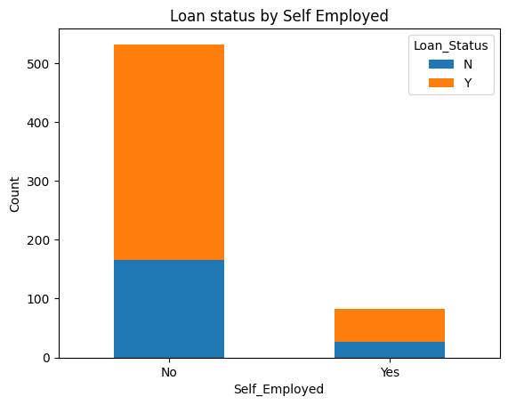
Here we analyze that every factor is impact the loan or not. Here we will analyse the Education
we will find the relation between the target variable (Loan status) and categorical independent variables (Self-Employed).
Gender | Total | Loan(%) (Y)
No | 532 (87%) | 366 (69%)
Yes | 82 (13%) | 56 (68%)

Slide 17
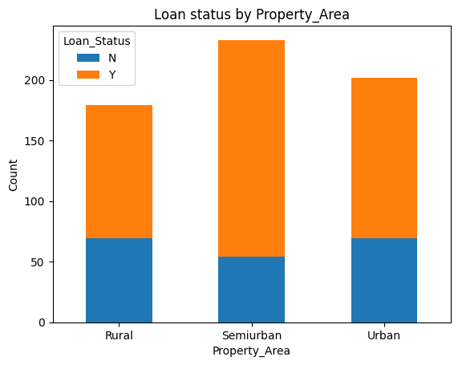
Here we analyze that every factor is impact the loan or not. Here we will analyse the Education
we will find the relation between the target variable (Loan status) and categorical independent variables (Property Area).
Gender | Total | Loan(%) (Y)
Rural | 179 (29%) | 110 (61%)
Semiurban | 233 (38%) | 179 (77%)
Urban | 202 (33%) | 133 (66%)

Slide 18
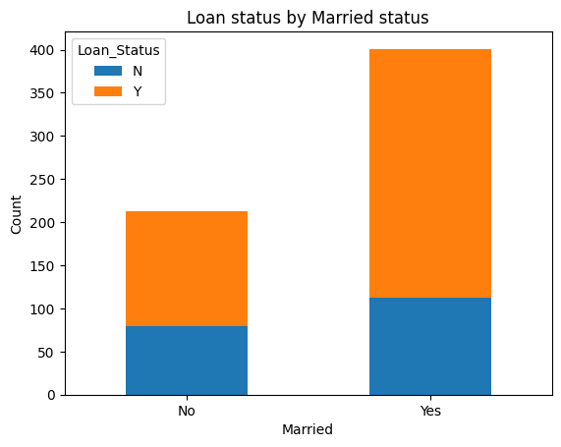
Here we analyze that every factor is impact the loan or not. Here we will analyse the Education
we will find the relation between the target variable (Loan status) and categorical independent variables (Married).
Gender | Total | Loan(%) (Y)
No | 213 (35%) | 134 (63%)
Yes | 401 (65%) | 288 (72%)

Slide 19
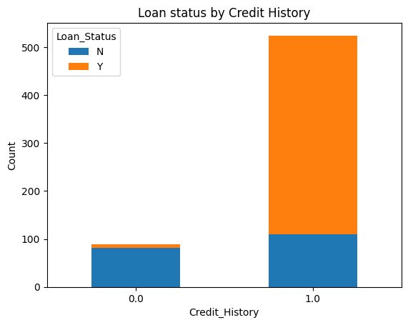
Here we analyze that every factor is impact the loan or not. Here we will analyse the Education
we will find the relation between the target variable (Loan status) and categorical independent variables (Creadit History).
Gender | Total | Loan(%) (Y)
0 | 89 (14%) | 7 (8%)
1 | 525 (86%) | 415 (80%)

Slide 20
Thank You

